Slide 1



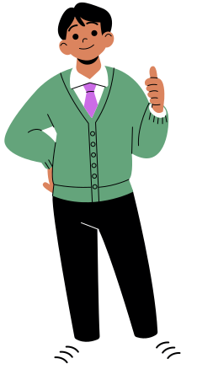

A Day in my Life as a Developer....
Neida Guzman , Niki Vahdati Panah, Jonathan Smith, Tolulope Ogundeji

Slide 2





7:30 AM
I wake up and start my day with a workout and a cup of coffee before I boot up my machine.
As a developer who is accustomed to regularly working with computer vision libraries like OpenCv and Pillow; today looks like a day full of image processing.

Slide 3



8:30AM
First off, I need to enhance a series of low lights for a my client in which I can use the amazing set of tools provided in OpenCV to complete. I then load the images using OpenCV and then convert them to grayscale. When it comes to more advanced image filtering and transformation, OpenCV thrives. Once I convert the images to grayscale, I apply histogram equalization to improve the contrast of the image.

Slide 4








9:30 AM
My next task involves resizing an image for a web application. My client has requested for multiple versions of their images in different resolutions, so I switch to Pillow to use the resize function. First, I load the images, resize them to their required dimensions, and then save them.
Pillow is a great addition to use in conjuction to Open CV when it comes to resizing, cropping, and basic manipulation through the Python interface.

Slide 5

11:00am
After a quick run rundown, I use Open CV to support the real-time image processing. I then process each frame for key point detection in this application. It is important that this project has the identified features in the images requested because this tracks their movements across frames.

Slide 6
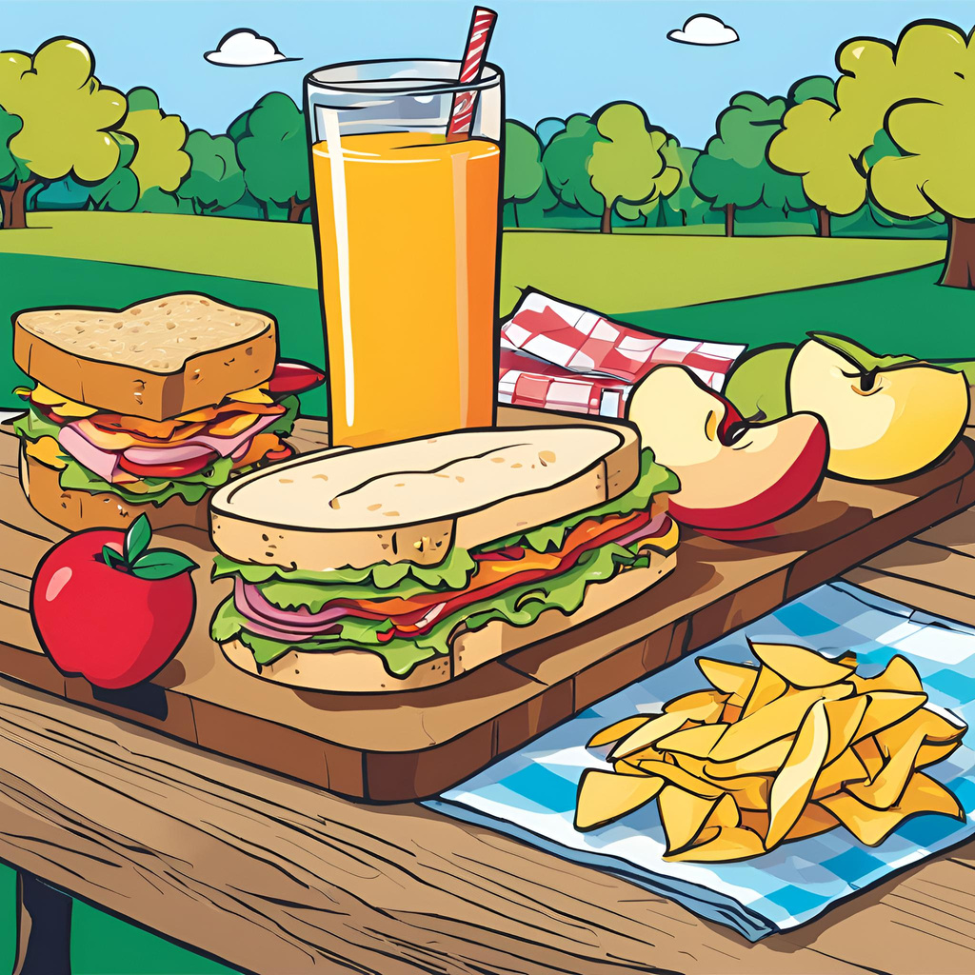

12:30pm
Lunch time! Enjoying my delicious food yet I cannot stop thinking about my task involving Pillow and Open CV.

Slide 7
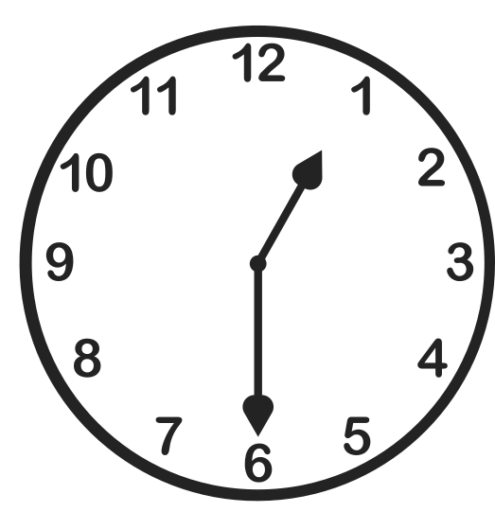

1:30 PM
Back at it. The image stitching task begins by pre-processing the individual images with Pillow to ensure consistent size and orientation. I start by rotating and cropping each image using image.rotate() and image.crop(), ensuring they align correctly. Once the images are properly oriented and sized, I feed them into OpenCV’s cv2.Stitcher_create() to perform the actual stitching. After some fine-tuning and adjustments, the panorama comes out nearly perfect. A little cleanup using Pillow to touch up the final output, and it's ready for the client.

Slide 8
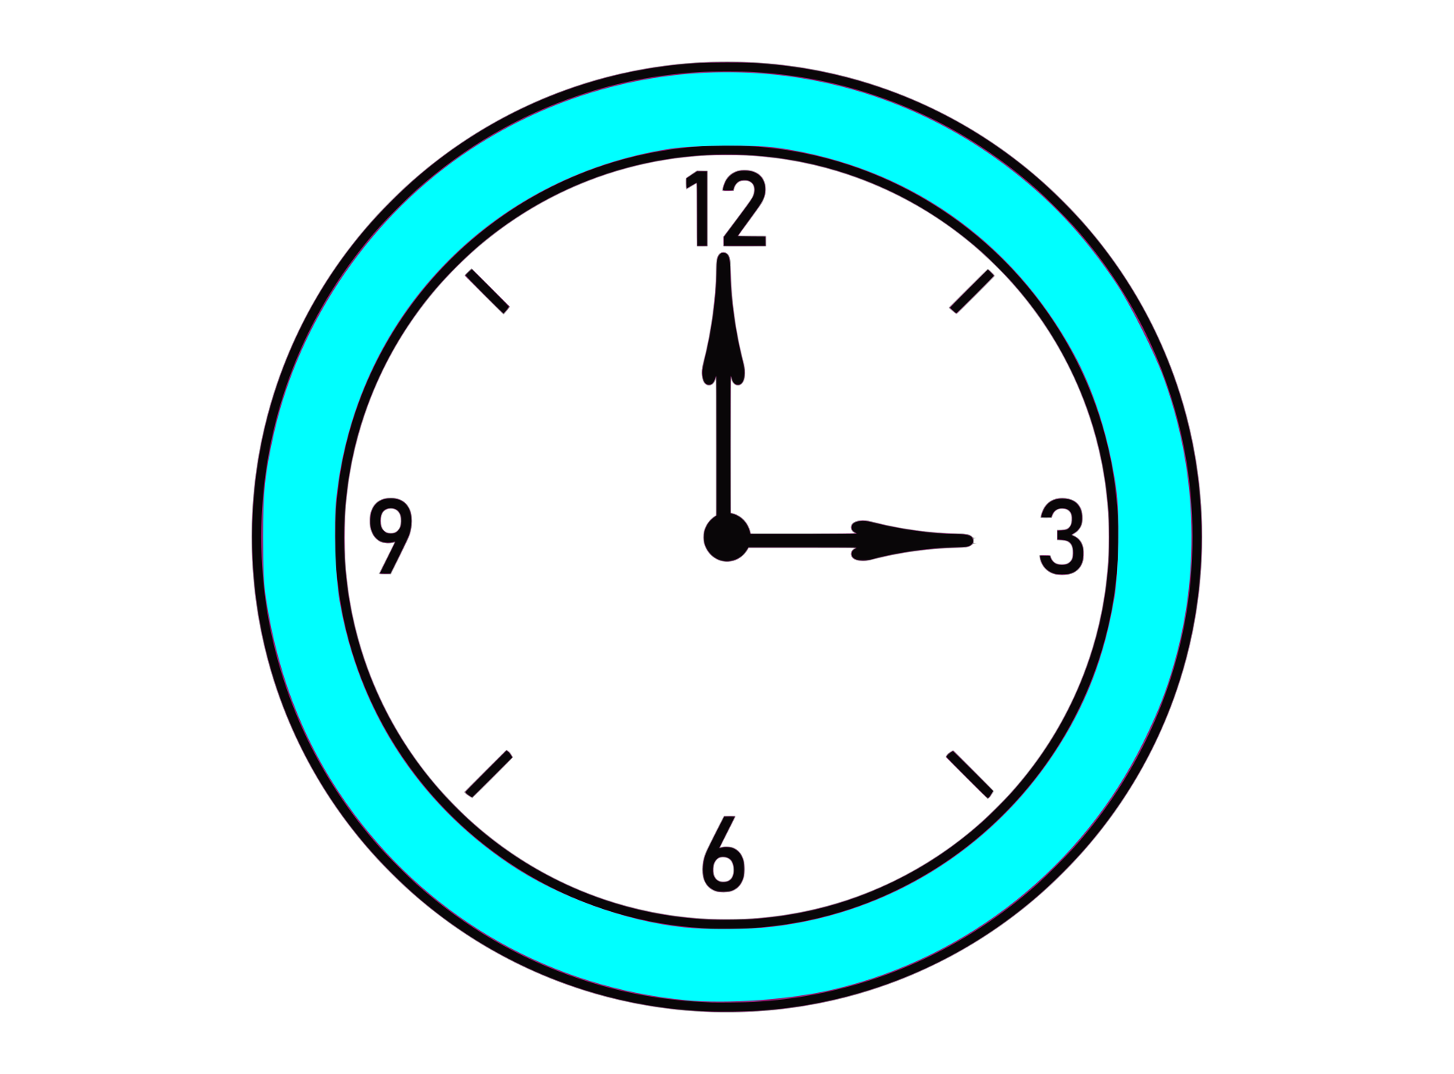

At 3:00 PM, a new request arrives—a client needs to detect faces in images and blur them for privacy reasons. OpenCV proves to be highly beneficial for this task. I begin by loading the images and utilize a pre-trained Haar Cascade classifier with cv2.CascadeClassifier() to identify the faces. After detection, I apply a Gaussian blur to the face area using cv2.GaussianBlur() and save the final result.

Slide 9
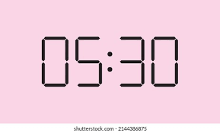
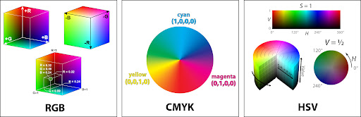
As I concluded the day's work, I reviewed the activities that we had progressed on so far and sorted the completed and pending tasks. I also went ahead and added some updates to our object detection model and sent some updates to the team.
The highlight of the day was color channel conversions, the process of changing colors from one color space to another. A major goal for tomorrow is to include advanced filtering options and faster image processing.

Slide 10
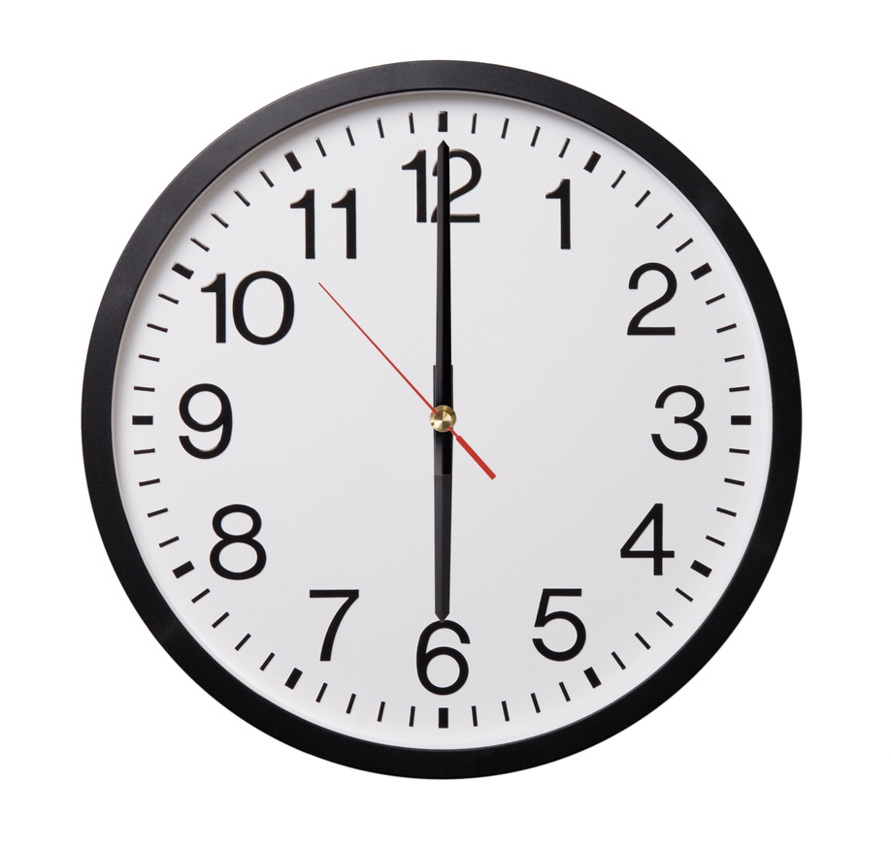
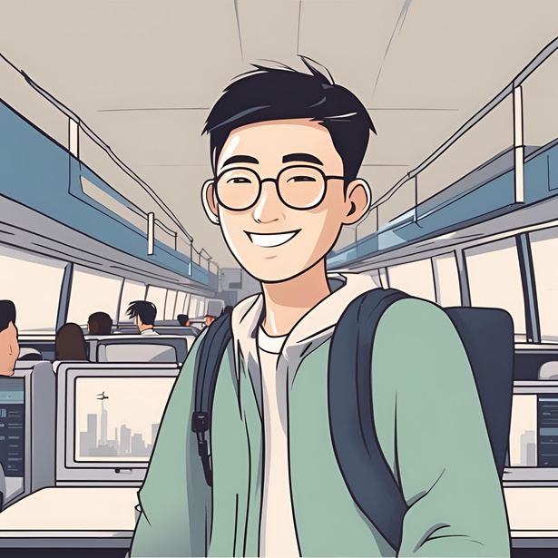
It is now 6pm, reflecting on today's accomplishments, it's clear that diving into OpenCV and Pillow has been highly rewarding. OpenCV, with its powerful capabilities for real-time computer vision, has expanded my understanding of image processing, object detection, and facial recognition.
I am heading home with a huge feeling of accomplishment as today was a productive day as usual, I am going to end the day reflecting on what I learned using OpenCV and pillow. Cannot wait for another day of coding tomorrow.

Slide 11

Works Cited
"Image Processing – OpenCV vs. PIL." GeeksforGeeks, 3 Nov. 2021,Accessed 17 Sept. 2024.
Pythoneers. “Image Processing in Python Using Pillow.” Medium, 15 Mar. 2023, https://medium.com/pythoneers/image-processing-in-python-using-pillow-7f7b650e06f5. Accessed 15 Sept. 2024.
"Image Processing – OpenCV vs. PIL." GeeksforGeeks, 3 Nov. 2021, https://www.geeksforgeeks.org/image-processing-opencv-vs-pil/. Accessed 15 Sept. 2024.

